Slide 1
Predict CTR of an Email Campaign
By Alka Dinesh Aswar
Code : https://www.kaggle.com/code/alkaaswar/notebookb06813256a/edit

Slide 2
PROJECT FLOW
Business Problem
Load Dataset & Observe it
EDA and Visualization
Feature Engineering
Save the Result
Model Building

Slide 3
Predict CTR of an Email Campaign
Problem Statement
Most organizations today rely on email campaigns for effective communication with users. Email communication is one of the popular ways to pitch products to users and build trustworthy relationships with them.
Email campaigns contain different types of CTA (Call To Action). The ultimate goal of email campaigns is to maximize the Click Through Rate (CTR).
CTR is a measure of success for email campaigns. The higher the click rate, the better your email marketing campaign is. CTR is calculated by the no. of users who clicked on at least one of the CTA divided by the total no. of users the email was delivered to.
CTR = No. of users who clicked on at least one of the CTA / No. of emails delivered
CTR depends on multiple factors like design, content, personalization, etc.

Slide 4
Load Dataset & Observe it
In this step data will be loading on 3 files
1 ) train.xlsx
2) test.xlsx
3) sample_submission

Slide 5
EDA and Visualization
In EDA we perform some operations and see the data ‘IN and OUT’
1 ) shape : 1888 rows and 22 columns
2 ) click_rate is our target variable and it has continuous type of value means we have to use regression algorithms
3) duplicated() : 0
4) info() : using this function we can see the data type and null values
5) describe() : It will describe the data
SO like that functions we used

Slide 6
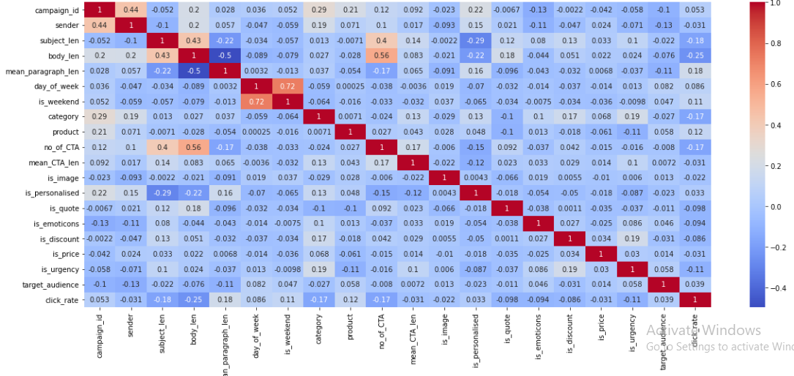
Visualization
Bi - Variant Analysis
Using this graph we can see which features are highly correlated with each other
Here we can see the most correlated features
1) is_weekend with day_of_week
2) no_of_CTA with body_len

Slide 7
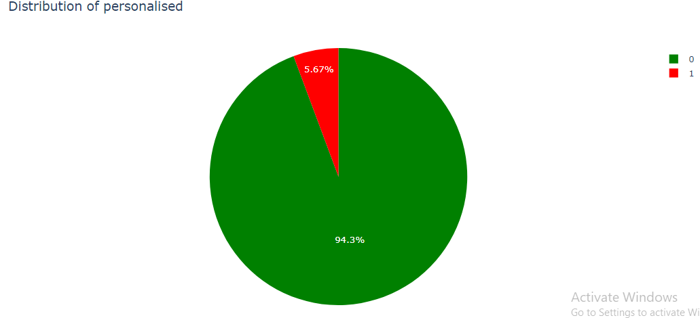
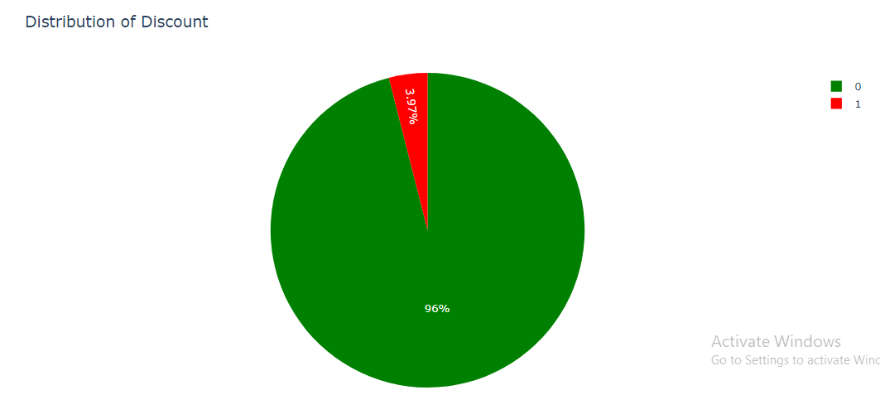
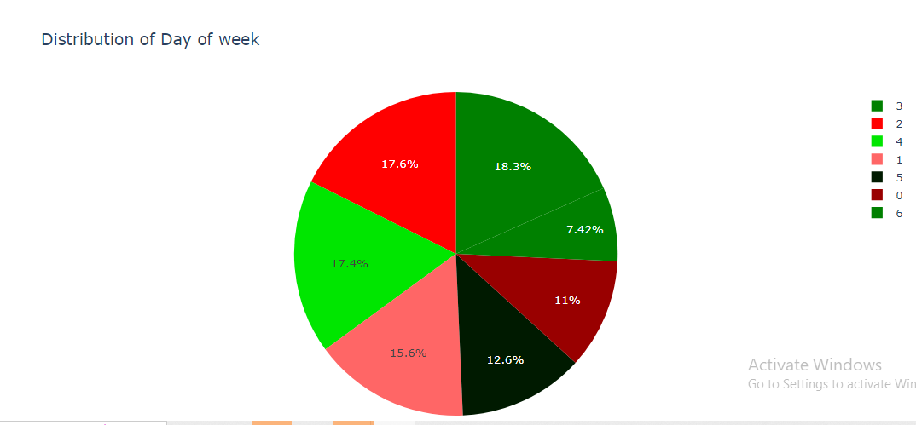
Pie Chart
In 1st pie chart max customer has no personalized email
There are maximum no of customer is not interested in discounts email
max email are send on 3 day of week

Slide 8
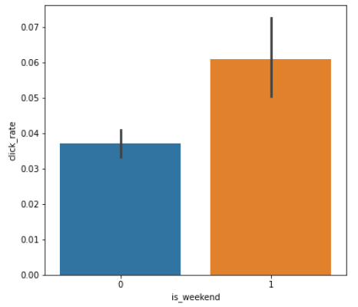
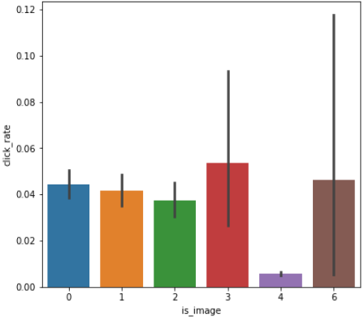
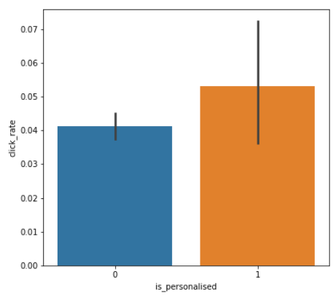
Bar Graph
Is_weekend
Is_image
Is_personalized

Slide 9

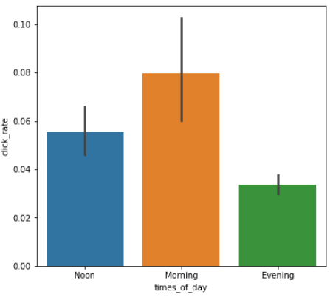
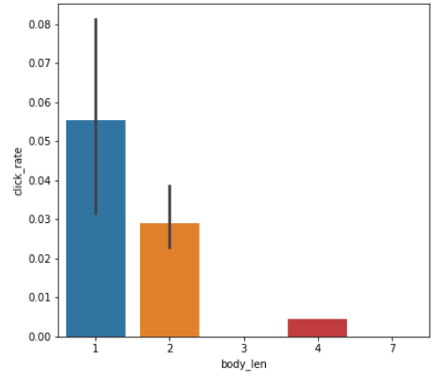
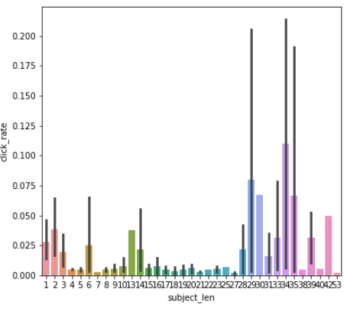
Times_of_day
Body_len
Subject_len

Slide 10
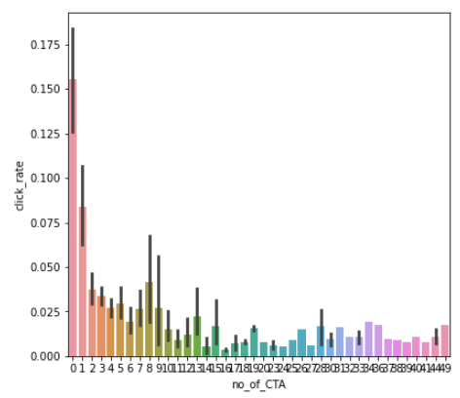
Observation
1) In 1st graph we can see the click rate is high if that day is weekend so we should sent the Email on weekend
2) Here we can see if the no of images in the email then we will get click rate in high range so we should keep the Images in the email not more than 3
3) If a email is personalized then there will be high click rate
4) Here we can see if the subject length is high then there is high chances that customer will click on email This graph showing that no of character's in the body of Email should be very low and efficient way .
5) Body length of the mail should be low and efficient
6) Customers are highly click on email in the morning time
7) Customers are not interested on Call To Actions in an email
8) There are highly fluctuations are there.

Slide 11
Feature Engineering
There are one object column that is times_of_day so used one hot encoding technique here
Used standard scaler method to scale the data in one range
Used Feature construction and Feature Extraction techniques

Slide 12
Model Building
In model building techniques there are some algorithms are use like
Gradient Boosting Repressor
from sklearn.ensemble import GradientBoostingRegressor
Linear regression
from sklearn import linear_model
Decision tree
from sklearn.tree import DecisionTreeRegressor
KNN
from sklearn.neighbors import KNeighborsRegressor
So, Using this algorithms we predicted the result for our test data and got the highest accuracy using Gradient boosting also used k fold cross validation techniques , so the result of gradient boosting algorithm stored in a
sample _submissiofinal .csv

Slide 13
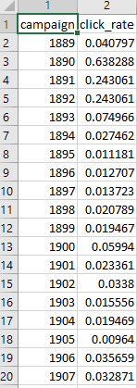
Save The Result In File
Final Result is looking like this
Using gbr_submission.to_csv('sample_submission.csv', index=False, header=True)
save the data into a file
'sample_submission.csv file have 2 table that is campaign_id and click_rate

Slide 14
Coclusion
How do you design the email content effectively?
Ans : 1. The Email should not be a part Discount
Good morning Sir/Madam
Hope your doing well
2. Subject should can be long but more effective
Like we have the great opportunity that you are looking for
3. In body we have to add very short content with an images or slide sharing.
What should your subject line look like?
Ans : Subject like should be long but we have to add our content in effective way so that customer will have the curiosity to know more about this mail
What should be the length of the email?
Ans : Length of email should be small because customer is not interested to read more .
Do you need images in your email template?
Ans : Yes images is most important because if body length will be low so we cant deliver our content to the customer so using image it will easily understand to them so its needed

